Slide 1

Object-Oriented Programming (OOP) Basic Concepts in c++

Slide 2

What is oop ?
Object-oriented programming (OOP) is a programming paradigm based upon objects that aims to incorporate the advantages of modularity, reusability, and maintainability.

Slide 3







Procedural
OOP
Focus is on the sequence of operations rather than the Data.
Focus is on the Data rather than sequence of operations.
Writing a series of steps become complex for large programs.
We can easily model large real-world concepts using OOP.
Poor maintainability and reusability
OOP approach offers great reusability and maintainability
Notes:
Why do we need oop While we have procedural programming ?
Three reasons from three point of view

Slide 4
Class
Object
Encapsulation
OOP Concepts
Abstraction
Polymorphism
Inheritance

Slide 5
fundamental components of OOP
Principles of OOP
Class
Object
Encapsulation
OOP Concepts
Abstraction
Polymorphism
Inheritance

Slide 6
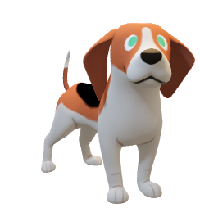
What is an Object ?
Identity
It gives a unique name to an object.
Name of Dog
Age Color
State
It is represented by attributes of an object.
Bark Sleep
Behavior
It is represented by methods of an object.
Dog Object
Notes:
It is a basic unit of Object Oriented Programming and represents the real life entities

Slide 7



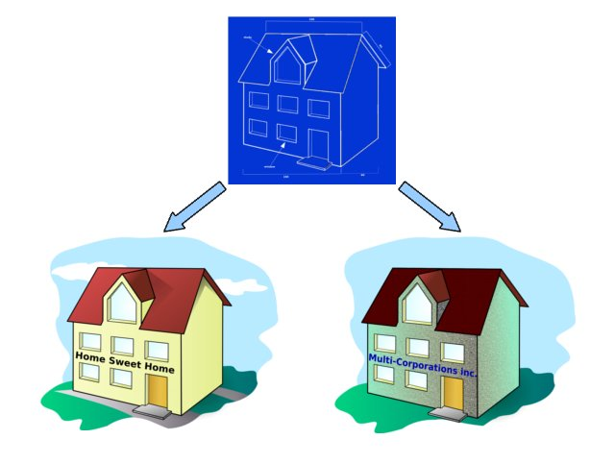
What is a Class ?
A class is a set of instruction.
Member Variables
Methods
It is also referred as blueprint.
Notes:
A class is a set of instruction that describes what an object will contain (members variables) and determines how the object will behave (Methods).

Slide 8
writing a class in c++
Creating Object
Keyword
Class Name
class Dog {
// Properties or Member Variables
public:
String breed;
String size;
// method
void run() {
cout<<"Running . . .";
}
}
Keyword
// Creating Object
Dog maltese;
//Accessing variables and methods
maltese.breed = "Maltese";
maltese.size = "Small";
maltese.run();

Slide 9

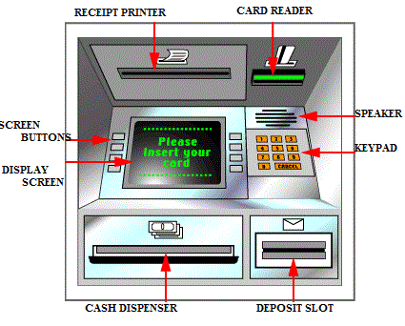
Encapsulation
Class
Public members
Outside Code
Private members
Notes:
Encapsulation is the act of wrapping up of attributes(represented by data members) and operations (represented by functions) under one single unit (represented by class).

